Slide 1
OK+ application
A way to buy and sell different products

Slide 2
Summary
Use-case diagram
Scenario
Sequence diagram
Domain model
Demonstration

Slide 3
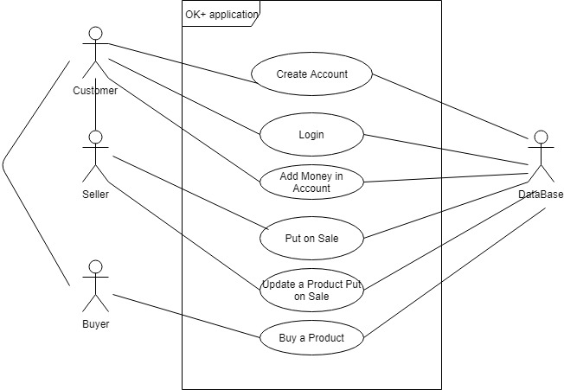
Use-case diagram

Slide 4
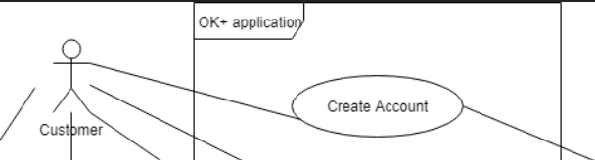
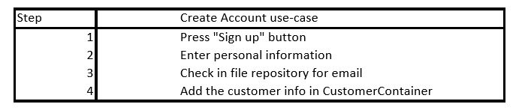
Our scenario

Slide 5
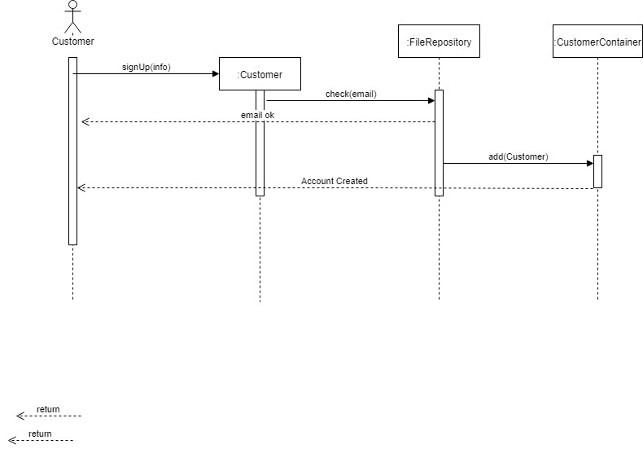
The scenario sequence diagram

Slide 6
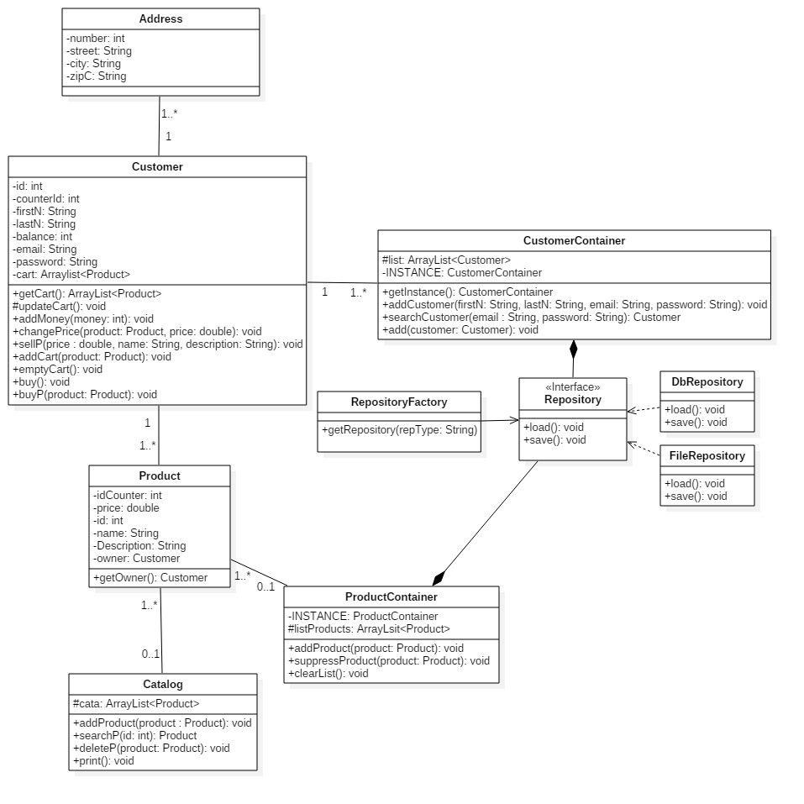
OK+ domain model

Slide 7
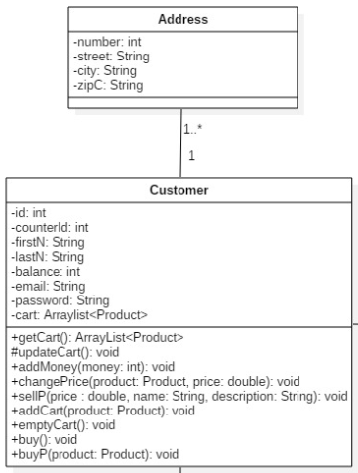
OK+ domain model

Slide 8
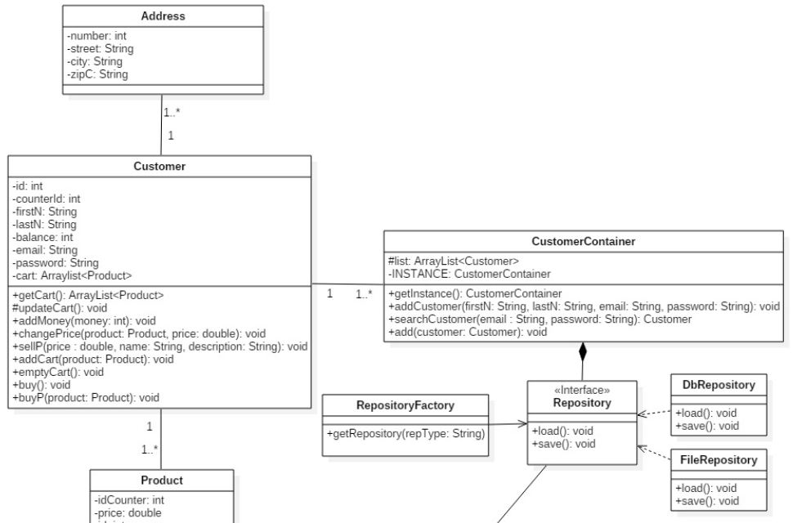

OK+ domain model (scenario)

Slide 9
Let us show you our application

